Slide 1
DevOps Demo with Docker in AWS
Month 1, Year

Slide 2
Requirement
Showcase CI/CD in AWS using Docker containers .
Scaling (SWARM) for docker as well as docker hosting servers.
Implement an automated procedure to setup environment quickly whenever required and shutdown after use.
Create a docker container with application layer.

Slide 3
CI / CD Model
Continuous Integration
Developers from single or multiple teams are uploading code to central version repository on regular basis and automated build to verify .
Continuous Deployment
New Code (or changes) from version repository are deployed (or pushed) continuously and are automatic to production environment.
Continuous Delivery
Can be released to production any time via a push button.

Slide 4



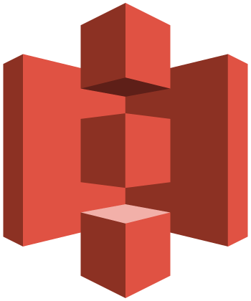
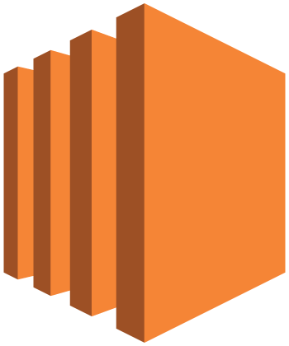
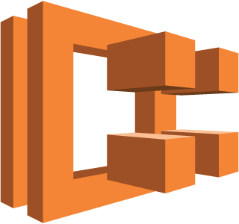


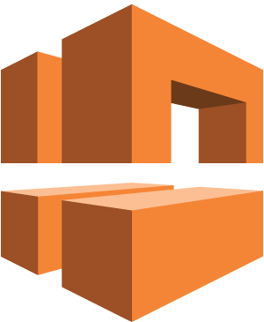
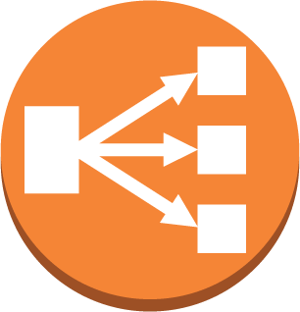


Solution
For above requirement , used below services
For Application Code
AWS CodePipeline
AWS CodeBuild
Amazon ECR
Amazon ECS
Amazon S3
Amazon EC2
IAM
VPC subnet
router
Amazon VPC
Classic Load Balancer
Internet gateway
Auto Scaling group
security group
GIT

Slide 5
Virtualization and Containers
VIRTUALIZATION
CONTAINERIZATION
APP A
APP A
APP B
VM
BINS / LIBS
BINS / LIBS
BINS / LIBS
APP A
APP A
APP B
APP B
CONTAINERS
Guest OS
Guest OS
Guest OS
HYPERVISOR
BINS / LIBS
BINS / LIB
HOST OS
HOST OS , SHARED SERVICES
HARDWARE
HARDWARE

Slide 6
How to use container – I
APP
OS Layer

Slide 7
How to use container - II
APP
Override parameter
OS Layer

Slide 8

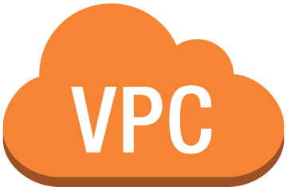
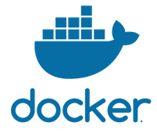
Environment Setup
Developers
Classic Load Balancer
Amazon EC2
Amazon ECS
Amazon EC2
Subnet Pub1 | 10.0.1.0/24 | us-east-1a
Subnet Pub2 | 10.0.3.0/24 | us-east-1c
8
Amazon ECR

Slide 9
Deployment Workflow
AWS CodeBuild
Amazon ECR
AWS CodePipeline
Developers
GIT
Amazon ECS
Amazon EC2

Slide 10
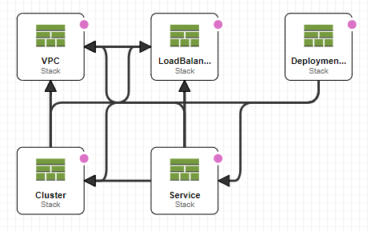
Stack Diagram

Slide 11
Q/A

Slide 12
Thank You

